Slide 1
Natural selection and adaptation
Dan Schrider
UFPR
2024

Slide 2
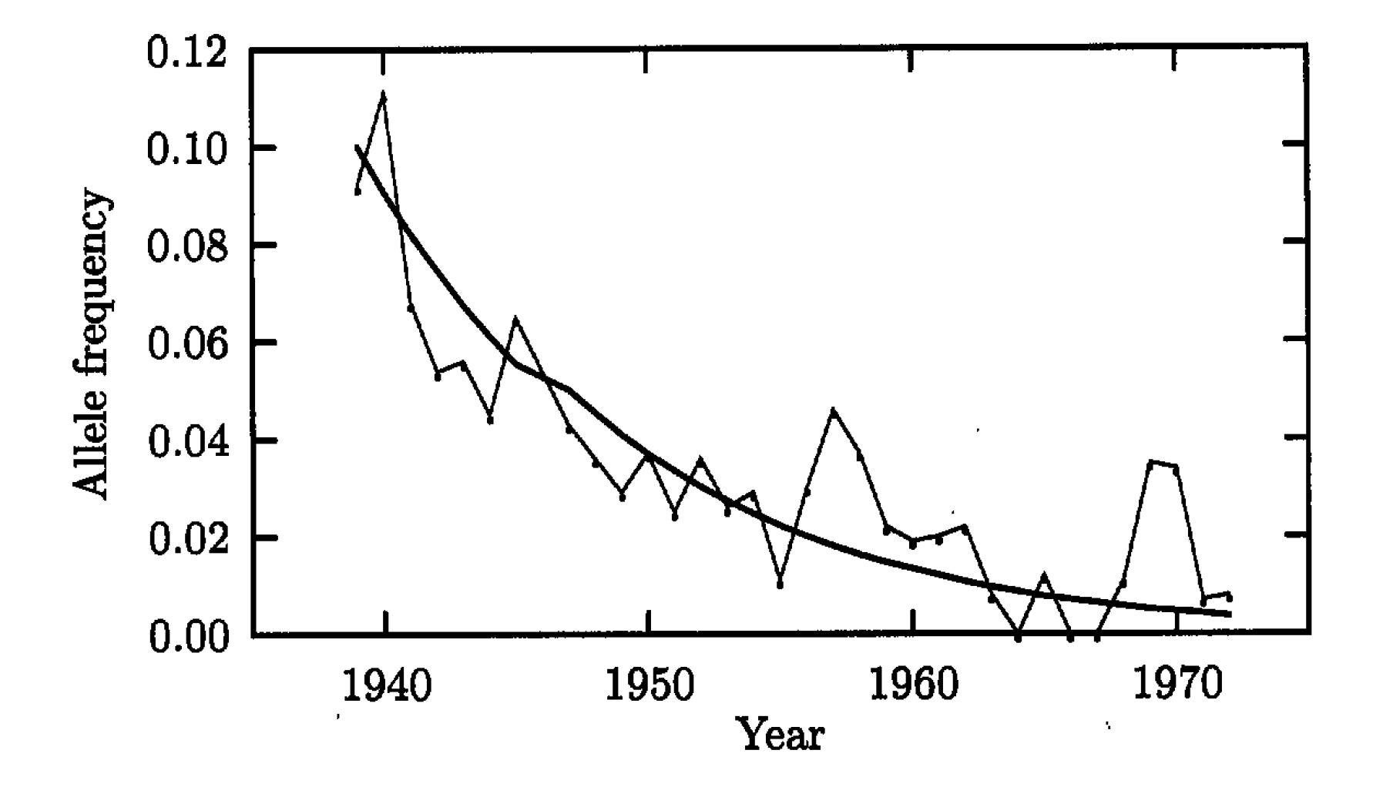
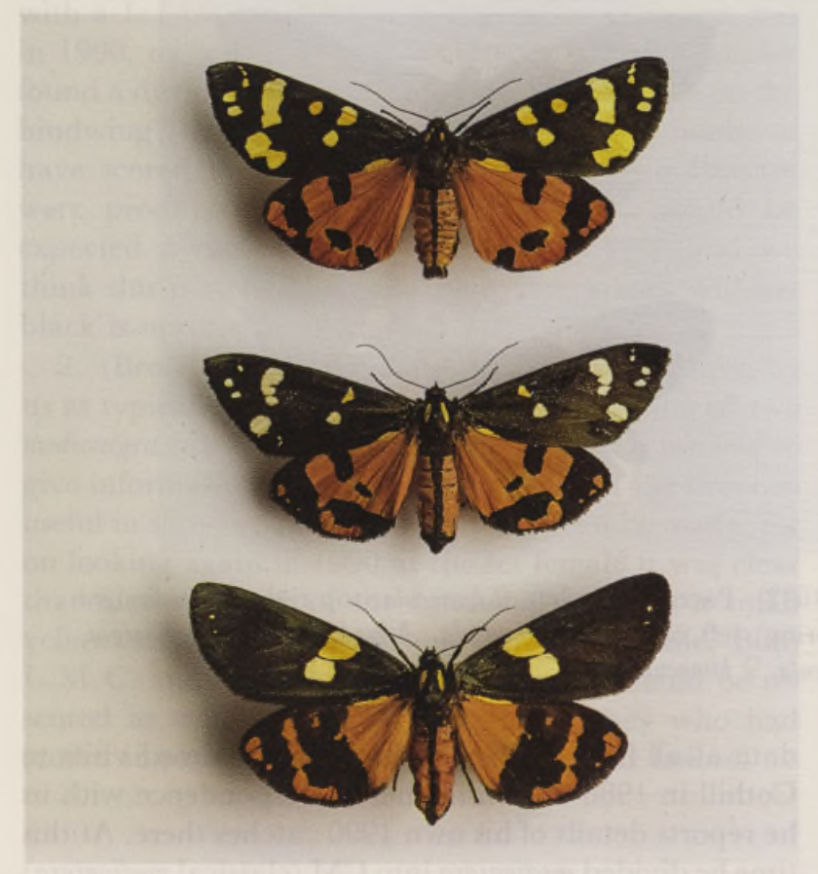
Frequency of medionigra allele in the European scarlet tiger moth
Can we infer whether this trend is driven by natural selection?

Slide 3
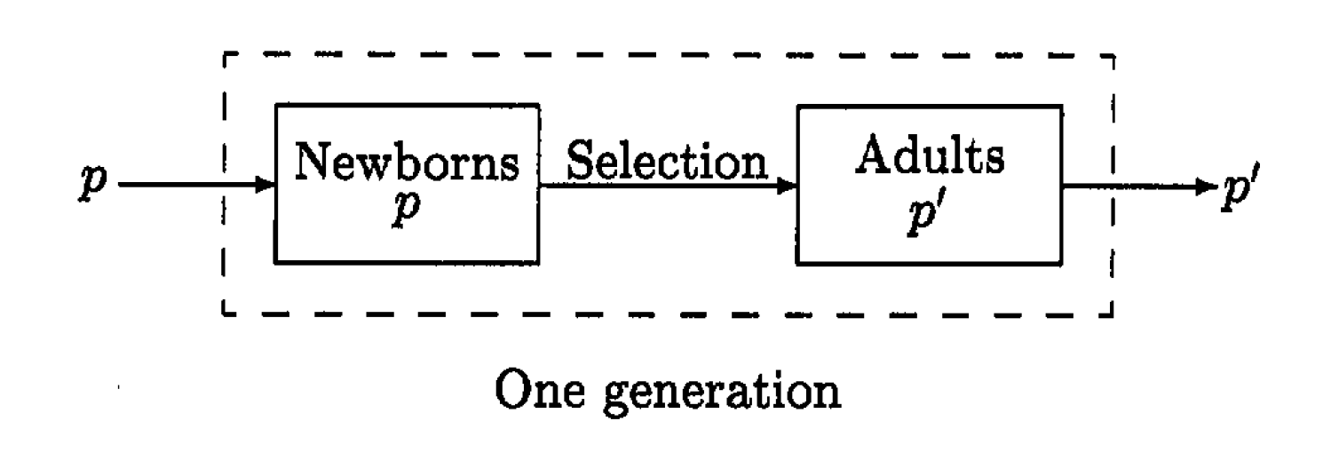
Fundamental model of selection

Slide 4
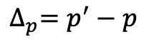
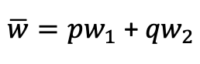
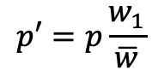
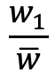
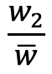
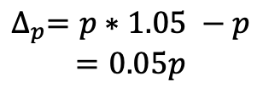
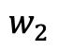
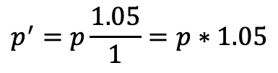
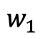
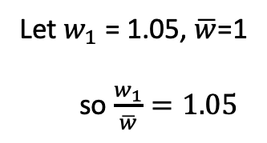
Allele frequency change in the fundamental model of selection
Fitness of A₁ allele:
$$w_{1}$$
Fitness of A₂ allele:
$$w_{2}$$
Mean population fitness:
$\overline{w}=pw_{1}$ + ${qw}_{2}$
Let $w_{1}$ = 1.05, $\overline{w}$=1
so $\frac{w_{1}}{\overline{w}}=1.05$
Relative fitness of A₁, A₂ alleles:
$$\frac{w_{1}}{\overline{w}}$$
$$\frac{w_{2}}{\overline{w}}$$
,
Frequency of A₁ in the next generation:
$$p′=p\frac{w_{1}}{\overline{w}}$$
$$p^{′}=p\frac{1.05}{1}=p∗1.05$$
Per-generation change in frequency of A₁:
$${∆_{p}=p}^{′}−p$$
$$∆_{p}=p∗1.05 −p$$
$$=0.05p$$

Slide 5
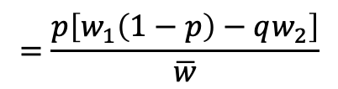
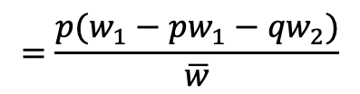
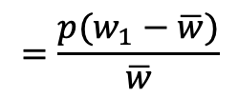
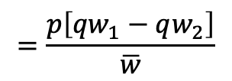
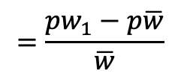
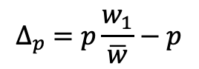
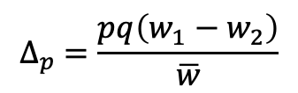
Allele frequency change in the fundamental model of selection
$$∆_{p} =p\frac{w_{1}}{\overline{w}}−p$$
Fitness of A₁ allele:
$$w_{1}$$
$$=\frac{{pw}_{1}−p\overline{w}}{\overline{w}}$$
Fitness of A₂ allele:
$$w_{2}$$
$$=\frac{{p(w}_{1}−\overline{w})}{\overline{w}}$$
Mean population fitness:
$\overline{w}=pw_{1}$ + ${qw}_{2}$
$$=\frac{{p(w}_{1}−pw_{1}−{qw}_{2})}{\overline{w}}$$
Relative fitness of A₁, A₂ alleles:
$$\frac{w_{1}}{\overline{w}}$$
$$\frac{w_{2}}{\overline{w}}$$
,
$$=\frac{p\left[w_{1}\left(1−p\right)−qw_{2}\right]}{\overline{w}}$$
Frequency of A₁ in the next generation:
$$p′=p\frac{w_{1}}{\overline{w}}$$
$$=\frac{p\left[{qw}_{1}−qw_{2}\right]}{\overline{w}}$$
Per-generation change in frequency of A₁:
$${∆_{p}=p}^{′}−p$$
$$∆_{p} =\frac{pq\left(w_{1}−w_{2}\right)}{\overline{w}}$$

Slide 6
The allele frequency trajectory of a beneficial mutation
(in generations)

Slide 7
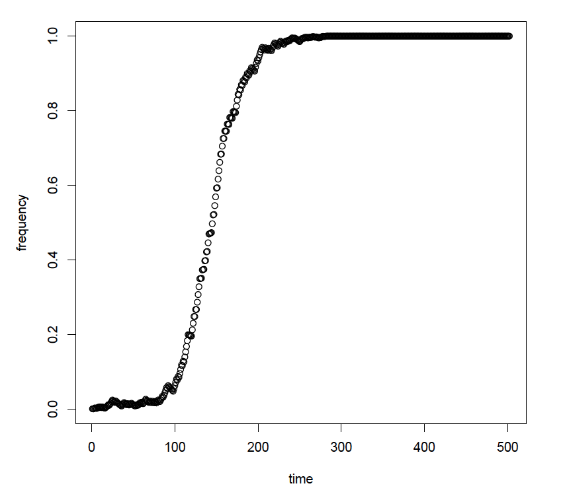
Selection + Drift
And most new beneficial alleles will never make it this far…
P(fixation) = ~2s
Notes:
Let’s take a look in GillespieLand!

Slide 8
Detecting natural selection in the genome
What if all we have is genomic data from one time point?

Slide 9
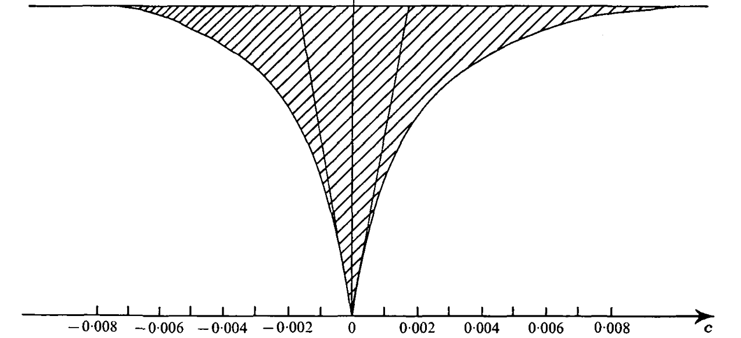
But, a single adaptive fixation has a profound effect on diversity
Maynard Smith and Haigh (1974)

Slide 10
Sweeps produce low- and high-frequency derived alleles
Cut to the tape!

Slide 11
One way to find sweeps: use the SFS
Compare the allele frequencies surrounding a focal site to those expected under neutrality.
In humans: positive selection on pigmentation, central nervous system development, immune function, olfactory receptors, and more
Nielsen et al. (2005), Williamson et al. (2007)

Slide 12
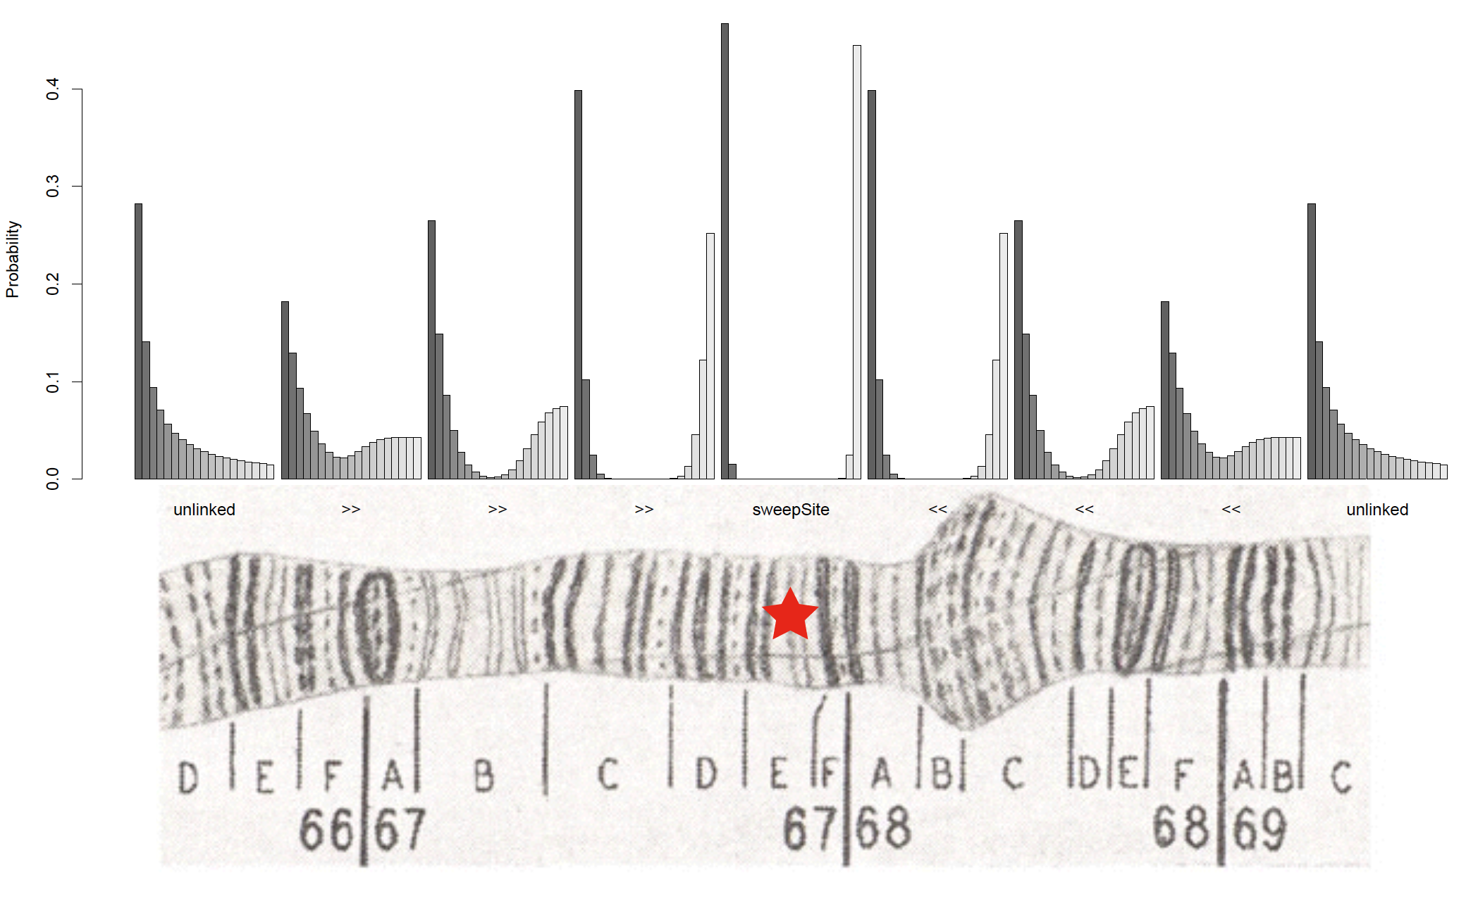
SweepFinder!
Nielsen et al. (2005)

Slide 13
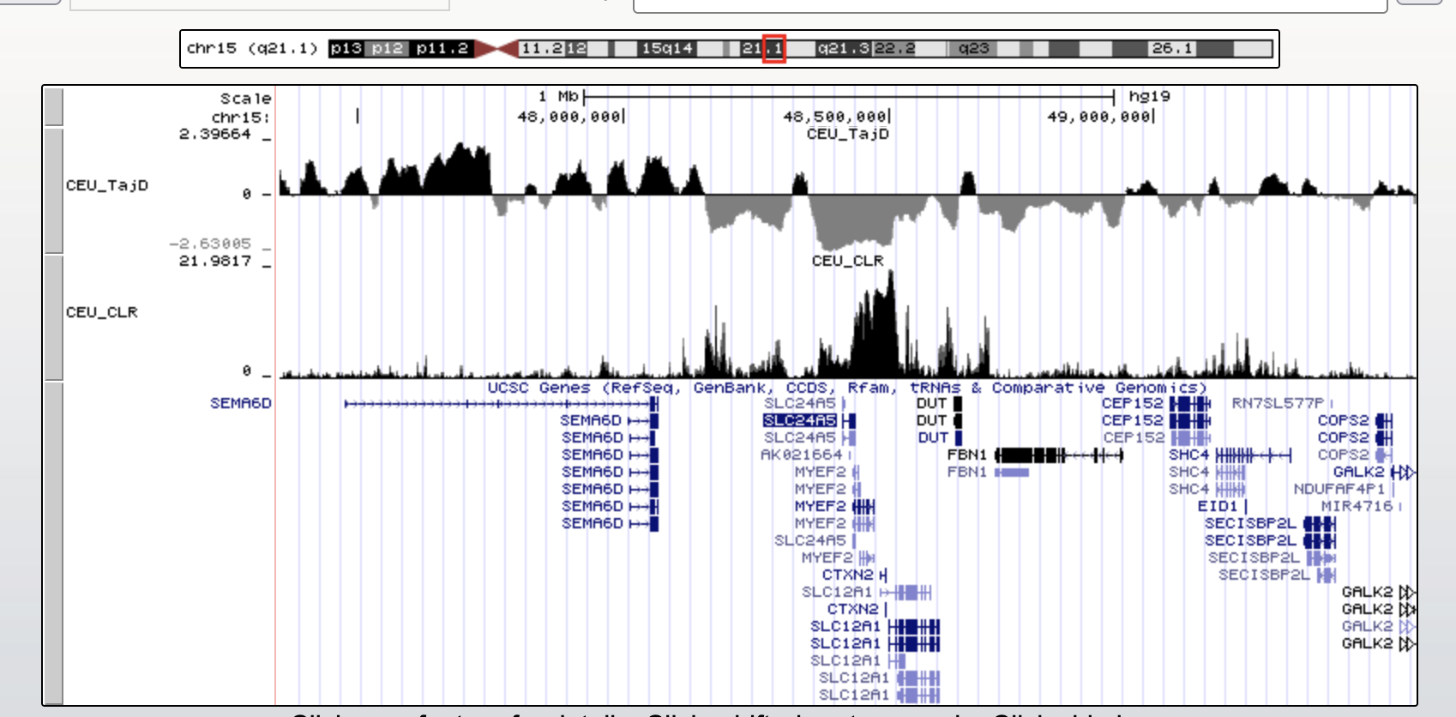
Strong selection on skin pigmentation in Europeans

Slide 14
Recent local adaptation
Very recent selection may cause allele frequencies to differ among populations
This could tells us about how selective pressures/responses differ across populations

Slide 15
F_{ST} and local adaptation
(π_{Tot} – π_{Within}) / π_{Tot}
Population 1
Population 2

Slide 16
F_{ST} and local adaptation
(π_{Tot} – π_{Within}) / π_{Tot}
Accelerated evolution in population 2
Population 1
Population 2

Slide 17
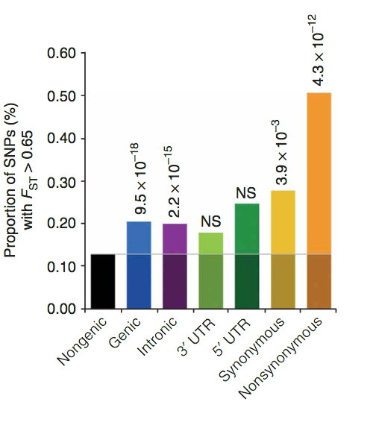
Elevated F_{ST} at nonsynonymous sites in humans
Barreiro et al. (2008)

Slide 18
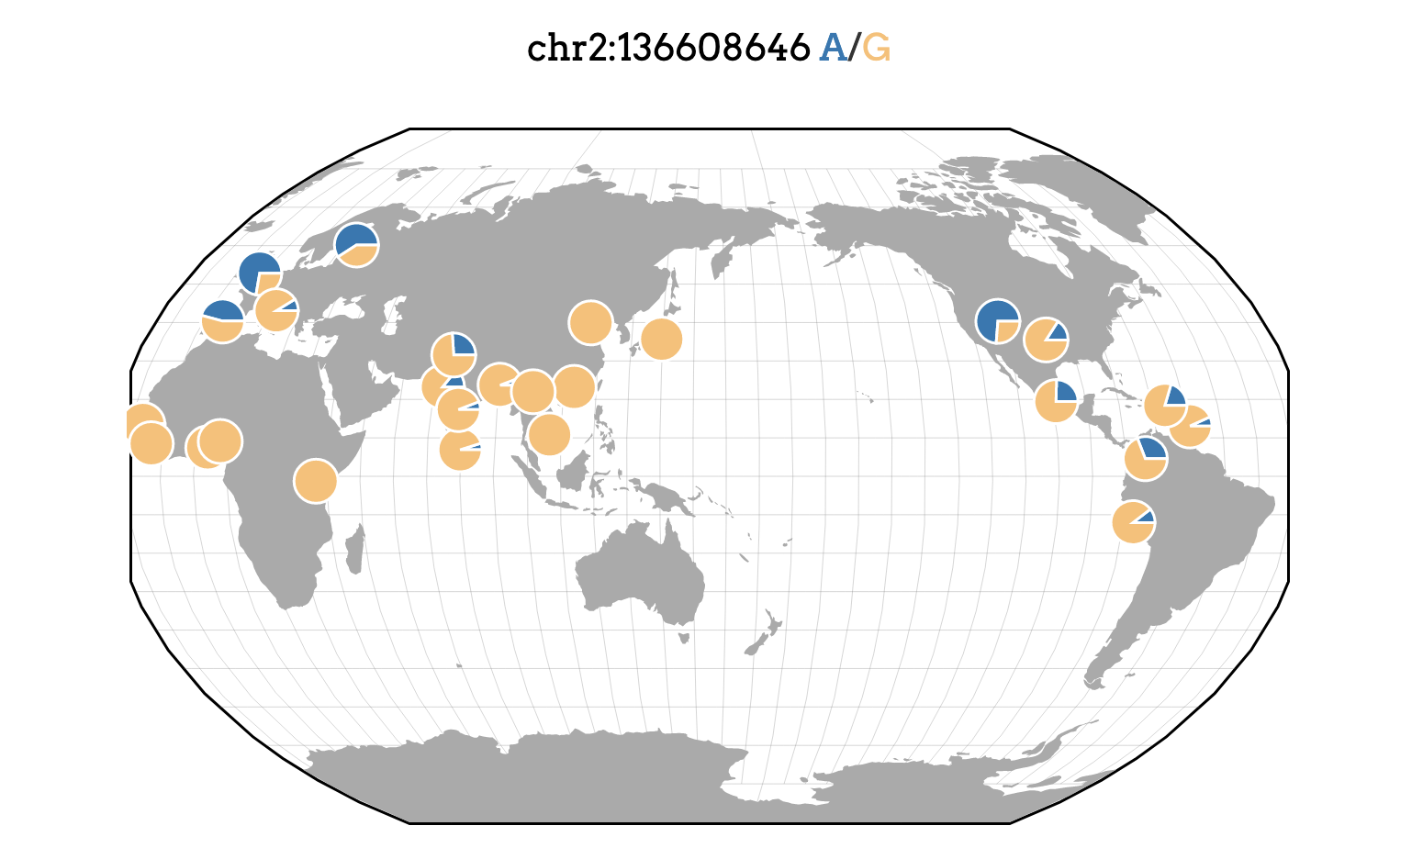
Elevated F_{ST} at a lactase persistence SNP
Assembly version: hg19
https://popgen.uchicago.edu/ggv/

Slide 19
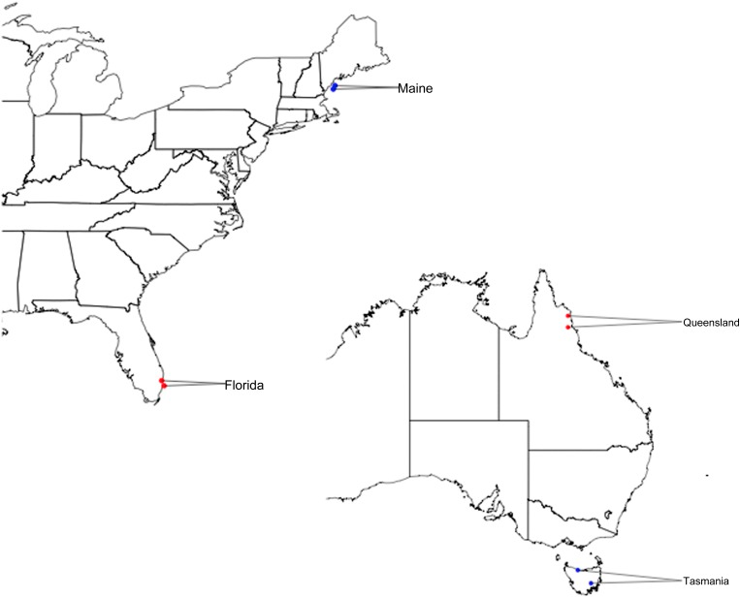
Local adaptation in Drosophila
Reinhardt et al. (2014)

Slide 20
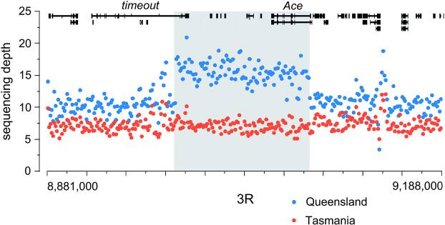
A massive duplication differentiated between Queensland and Tasmania
~100 kb

Slide 21
Ongoing selective sweeps
Sweeps happen quickly, but if they occur often we could potentially catch some in the act!
Hudson et al. (1994), Sabeti et al. (2001), Voight et al. (2006), Ferrer-Admetlla et al. (2014)

Slide 22
Ongoing selective sweeps
Hap div(x): probability that any two haplotypes bearing the x allele differ
Haplotype diversity(der)
Haplotype diversity(anc)

Slide 23
Ongoing selective sweeps
Hap div(x): probability that any two haplotypes bearing the x allele differ
Haplotype diversity(der)
Haplotype diversity(anc)
Must correct for frequency of derived allele

Slide 24
Fin

Slide 26
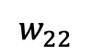
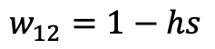
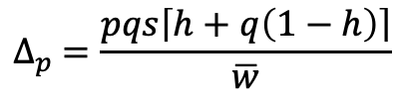
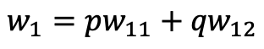
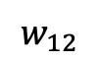
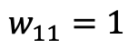
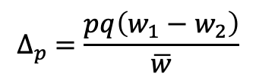
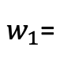
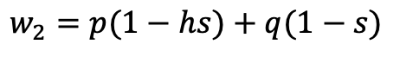
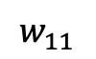
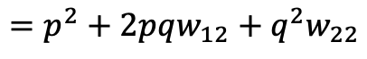
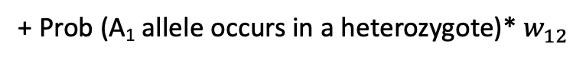
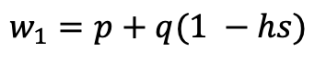
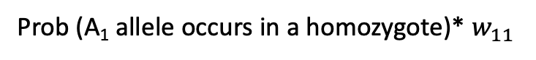
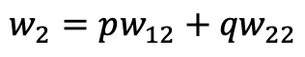
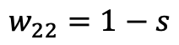
Selection in diploids
$$∆_{p} =\frac{pq\left(w_{1}−w_{2}\right)}{\overline{w}}$$
$$w_{11}$$
: fitness of A₁A₁ individuals
$w_{1}$=
Prob (A₁ allele occurs in a homozygote)* $w_{11}$
$$w_{12}$$
: fitness of A₁A₂ individuals
+ Prob (A₁ allele occurs in a heterozygote)* $w_{12}$
$$w_{22}$$
: fitness of A₂A₂ individuals
$$w_{1}=pw_{11}+{qw}_{12}$$
$$w_{2}=pw_{12}+{qw}_{22}$$
$$\overline{w}=p\left(pw_{11}+{qw}_{12}\right)+q\left(pw_{12}+{qw}_{22}\right)$$
$$=p^{2}+2pqw_{12}+q^{2}w_{22}$$
s: selection coefficient
h: dominance coefficient
h=0.5 : additive/codominant
h=0: A₁ is dominant
h=1: A₁ is recessive
h < 0, s > 0: A₁ is overdominant
h > 1, s > 0: A₁ is underdominant
$$w_{11}=1$$
$$w_{1}=p+q(1 −hs)$$
$$w_{12}=1−hs$$
$$w_{2}=p(1−hs)+q(1−s)$$
$$w_{22}=1−s$$
$$∆_{p} =\frac{pqs\left\lceil h+q\left(1−h\right)\right\rceil }{\overline{w}}$$

